Slide 1

DATABASE
TECHNOLOGIES
Relational model, Storage formats
and Indexing
Suresh Jamadagni
Department of Computer Science and Engineering

Slide 2

DATABASE TECHNOLOGIES
Relational model, Storage formats and Indexing
Suresh Jamadagni
Department of Computer Science and Engineering

Slide 3
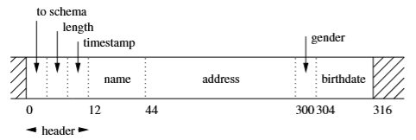
DATABASE TECHNOLOGIES
Secondary Storage Management – Arranging Data on Disks
Fixed-Length Records
Record consists of ﬁxed-length ﬁelds, one for each attribute of the represented tuple
Space not used by the previous ﬁeld is wasted.
The record begins with a header, a ﬁxed-length region where information about the record itself is kept
Example:
CREATE TABLE MovieStar ( name CHAR(30) PRIMARY KEY,
address VARCHAR(255),
gender CHAR(1),
birthdate DATE );

Slide 4
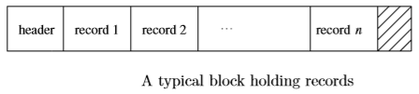
DATABASE TECHNOLOGIES
Secondary Storage Management – Arranging Data on Disks
Packing Fixed-Length Records into Blocks
Example:
Consider storing tuples of MovieStar table.
These records are 316 bytes long.
Consider block size of 8192 bytes. Of these, 12 bytes will be used for a block header, leaving 8180 bytes for data.
In this space we can ﬁt twenty five tuples of the given 316-byte format, and 280 bytes of each block are wasted space
If B is the block size and R is the record length of a fixed length record,
Blocking Factor = floor (B/R)

Slide 5
DATABASE TECHNOLOGIES
Secondary Storage Management – Block and Record Addresses
Physical Address
These are byte strings that let us determine the place within the secondary storage system where the block or record can be found.
One or more bytes of the physical address are used to indicate each of:
The host to which the storage is attached
An identiﬁer for the disk or other device on which the block is located
The number of the cylinder of the disk
The number of the track within the cylinder
The number of the block within the track
(In some cases) the oﬀset of the beginning of the record within the block.

Slide 6
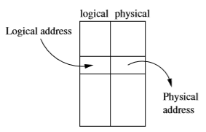
DATABASE TECHNOLOGIES
Secondary Storage Management – Block and Record Addresses
Logical Address
Each block or record has a “logical address,” which is an arbitrary string of bytes of some ﬁxed length.
A map table, stored on disk in a known location, relates logical to physical addresses

Slide 7
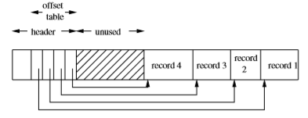
DATABASE TECHNOLOGIES
Secondary Storage Management – Block and Record Addresses
Many combinations of logical and physical addresses are possible, yielding structured address schemes
A block with a table of oﬀsets telling us the position of each record within the block
The address of a record is now the physical address of its block
plus the oﬀset

Slide 8
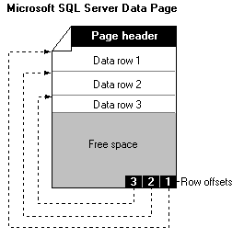
DATABASE TECHNOLOGIES
Storage Allocation in SQL Server
The fundamental unit of data storage in Microsoft® SQL Server™ is the page.
The page size is 8 KB. This means SQL Server databases have 128 pages per megabyte.
The start of each page is a 96-byte header used to store system information, such as the type of page, the amount of free space on the page, and the object ID of the object owning the page
Extents are the basic unit in which space is allocated to tables and indexes. An extent is 8 contiguous pages, or 64 KB. This means SQL Server databases have 16 extents per megabyte.

Slide 9
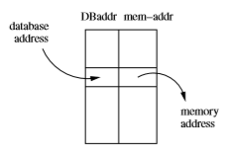
DATABASE TECHNOLOGIES
Secondary Storage Management – Pointer Swizzling
Every block, record, object, or other referenceable data item has two forms of address: its database address in the server’s address space and a memory address if the item is currently copied in virtual memory
To avoid the cost of translating repeatedly from database addresses to memory addresses, several techniques have been developed that are collectively known as pointer swizzling
When a block is moved from secondary storage to main memory, pointers within the block may be “swizzled,” that is, translated from the database address space to the virtual address space.

Slide 10
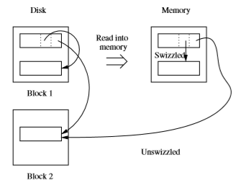
DATABASE TECHNOLOGIES
Secondary Storage Management – Pointer Swizzling
A pointer actually consists of:
A bit indicating whether the pointer is currently a database address or a (swizzled) memory address.
The database or memory pointer, as appropriate. The same space is used for whichever address form is present at the moment.
Example:
The Figure shows a simple situation in which the Block 1 has a record with pointers to a second record on the same block and to a record on another block. The ﬁgure also shows what might happen when Block 1 is copied to memory. The ﬁrst pointer, which points within Block 1, can be swizzled so it points directly to the memory address of the target record. However, if Block2 is not in memory at this time, then we cannot swizzle the second pointer; it must remain unswizzled, pointing to the database address of its target.

Slide 11
DATABASE TECHNOLOGIES
Secondary Storage Management – Swizzling Strategies
Automatic Swizzling
As soon as a block is brought into memory, all its pointers and addresses are inserted into the translation table
Swizzling on Demand
Leave all pointers unswizzled when the block is ﬁrst brought into memory, If a pointer P inside the block of memory is referenced, swizzle it
No Swizzling
Never swizzle pointers
Programmer Control of Swizzling
Allow application programmer to specify explicitly that a block loaded into memory is to have its pointers swizzled

Slide 12
DATABASE TECHNOLOGIES
Secondary Storage Management – Returning Blocks to Disk
When a block is moved from memory back to disk, any pointers within that block must be “unswizzled”. That is, their memory addresses must be replaced by the corresponding database addresses
The translation table is used to associate addresses of the two types

Slide 13
DATABASE TECHNOLOGIES
Secondary Storage Management – Pinned Records and Blocks
A block in memory is said to be pinned if it cannot at the moment be written back to disk safely. A bit telling whether or not a block is pinned can be located in the header of the block
When a block is written to disk, we need to “unswizzle” any pointers in that block. We also need to make sure it is not pinned.

Slide 14
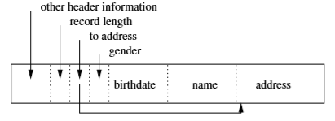
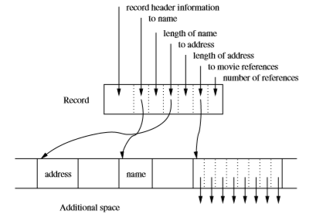
DATABASE TECHNOLOGIES
Secondary Storage Management – Arranging Data on Disks
Variable length records
Put all ﬁxed-length ﬁelds ahead of the variable-length ﬁelds.
In the record header, store the length of the record and Pointers to
the beginnings of all the variable-length ﬁelds
Example:
CREATE TABLE MovieStar ( name CHAR(30) PRIMARY KEY,
address VARCHAR(255),
gender CHAR(1),
birthdate DATE );

Slide 15
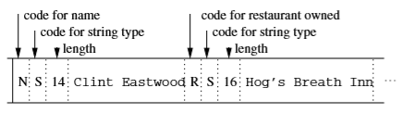
DATABASE TECHNOLOGIES
Secondary Storage Management – Arranging Data on Disks
Variable format records
Example:
CREATE TABLE MovieStar ( name CHAR(30) PRIMARY KEY,
address VARCHAR(255),
gender CHAR(1),
birthdate DATE );

Slide 16
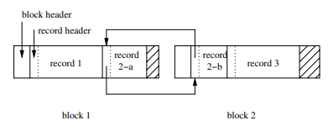
DATABASE TECHNOLOGIES
Secondary Storage Management – Arranging Data on Disks
Records That Do Not Fit in a Block
Each record or fragment header must contain a bit telling whether or not it is a fragment.
If it is a fragment, then it needs bits telling whether it is the ﬁrst or last fragment for its record.
If there is a next and/or previous fragment for the same record, then the fragment needs pointers to these other fragments.

Slide 17
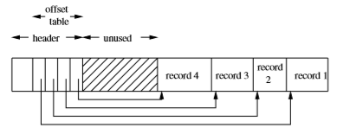
DATABASE TECHNOLOGIES
Secondary Storage Management – Arranging Data on Disks
Record Modification - Insert
If the tuples of a relation are kept in no particular order, ﬁnd a block with some empty space, or get a new block if there is none, and store the record there.
If the tuples must be kept in some ﬁxed order, such as sorted by their primary key, first locate the appropriate block for that record. If there is space in the block, store the new record and slide records around in the block to make space available at the proper point for insertion.

Slide 18
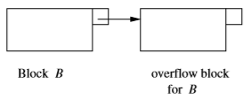
DATABASE TECHNOLOGIES
Secondary Storage Management – Arranging Data on Disks
Record Modification - Insert
If there is no room in the block for the new record,
Find space on a “nearby” block.
Create an overﬂow block

Slide 19
DATABASE TECHNOLOGIES
Secondary Storage Management – Arranging Data on Disks
Record Modification - Delete
Slide tuples around the block, compact the space in the block so there is always one unused region
If tuples cannot slide, maintain an available space list in the block header
Record Modification - Update
When a ﬁxed-length record is updated, there is no eﬀect on the storage
If the updated record is longer than the old version, then we need to create more space on its block. This process may involve sliding records or even the creation of an overﬂow block.
If the record shrinks because of the update, follow Delete operation steps

Slide 20
THANK YOU
Suresh Jamadagni
Department of Computer Science and Engineering
sureshjamadagni@pes.edu

